Slide 1

CLOUD COMPUTING
Introduction to Storage
Dr. Prafullata Kiran Auradkar
Department of Computer Science and Engineering
Acknowledgements:
Significant information in the slide deck presented through the Unit 3 of the course have been created by Dr. H.L. Phalachandra and would like to acknowledge and thank him for the same. There have been some information which I might have leveraged from the content of Dr. K.V. Subramaniam’s lecture contents too. I may have supplemented the same with contents from books and other sources from Internet and would like to sincerely thank, acknowledge and reiterate that the credit/rights for the same remain with the original authors/publishers only. These are intended for classroom presentation only.

Slide 2

CLOUD COMPUTING
Storage
Storage : An Introduction

Slide 3
CLOUD COMPUTING
Storage : Introduction
Data : A collection of raw facts
Types of Data :
Structured Data (Organized in rows and Columns and typically stored using say DBMS)
Unstructured Data (Cannot be organized and stored in rows and columns and difficult to uniquely id and retrieve and typically stored in object stores)
Data explosion in the last decade is leading to a prediction of 572 Zeta bytes (10²¹ bytes) by 2030 and expected to 50,000 Zeta bytes by 2050
Storage systems (and we are looking at external storage systems) will need to support the same.
These storage systems are characterized by their
Cost
Speed (access time) or performance
Reliability
Availability
Scalability
Management

Slide 4
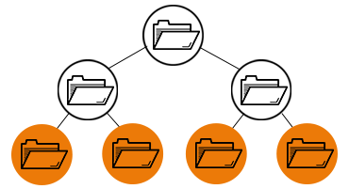
CLOUD COMPUTING
Storage : Understanding Data Storage
There are different types of storage based on the format in which the data is held, organized and presented. These are
File Storage : Organizes and represents data as a hierarchy of files in folders
Data is stored as a single piece of information inside a folder, just like you’d organize pieces of paper inside a manila folder. When you need to access that piece of data, your computer needs to know the path to find it
Data stored in files is organized and retrieved using a limited amount of metadata that tells the computer exactly where the file itself is kept.
Network Attached Storage (NAS) or the Direct Attached Storage (DAS) are examples of the same.
Scaling with file storage is typically scale out as there is a limit to addition of capacity to a system
https://www.redhat.com/en/topics/data-storage/file-block-object-storage

Slide 5
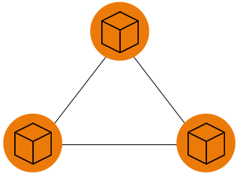
CLOUD COMPUTING
Storage : Understanding Data Storage (2)
Block Storage : block storage chunks data into arbitrarily organized, evenly sized volumes
Data is chopped into blocks with each block given an unique identifier allowing the storage system to place the data where-ever convenient
Block storage is often configured to decouple the data from the user’s environment and when data is requested, the underlying storage software reassembles the blocks of data from these environments and presents them back to the user
Usually used with SAN environments
It can be retrieved quickly and can be accessed by any environment
It’s an efficient and reliable way to store data and is easy to use and manage.
It works well with enterprises performing big transactions and those that deploy huge databases, meaning the more data you need to store, the better off you’ll be with block storage
Block storage can be expensive and it has limited capability to handle metadata, which means it needs to be dealt with in the application or database level

Slide 6
CLOUD COMPUTING
Storage : Understanding Data Storage (3)
Object Storage : manages data and links it to associated metadata
Object storage, also known as object-based storage, is a flat structure with the data broken into discrete units called objects and is kept in a single repository (instead of being kept as files in folders or as blocks)
Object storage volumes work as modular units:
Each is a self-contained repository that owns the data, a unique identifier that allows the object to be found over a distributed system, and the metadata that describes the data.
Metadata is important and includes details at two levels like age, privacies/securities, and access contingencies etc. and also have custom information about the object (data) itself information.
To retrieve the data, the storage operating system uses the metadata and identifiers, which distributes the load better and lets administrators apply policies that perform more robust searches.

Slide 7
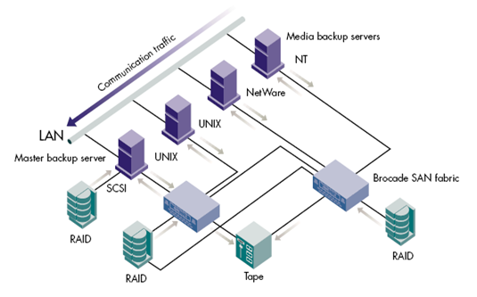
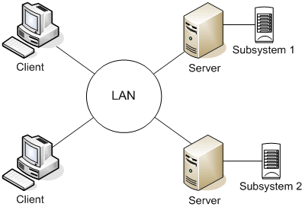
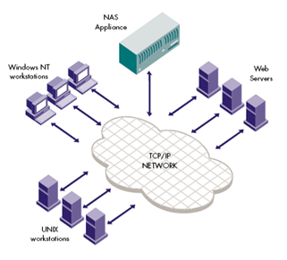
CLOUD COMPUTING
Storage Architectures to support these
Different ways of connecting storage devices and Servers in an network leads to different storage architecture
Directly Attached Storage (DAS)
Network Attached Storage (NAS)
Storage Area Network (SAN)
Additional SAN Port & network
(Switch)
Notes:
e

Slide 8
CLOUD COMPUTING
Evolution of the Storage Systems influenced by Architecture
Notes:
JBOD – Just a Bunch of Disks
IP SAN – I SCSI
Small Computer system interconnect
Internet based SCSI

Slide 9
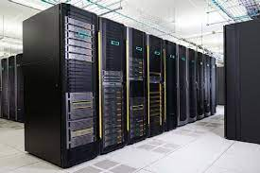
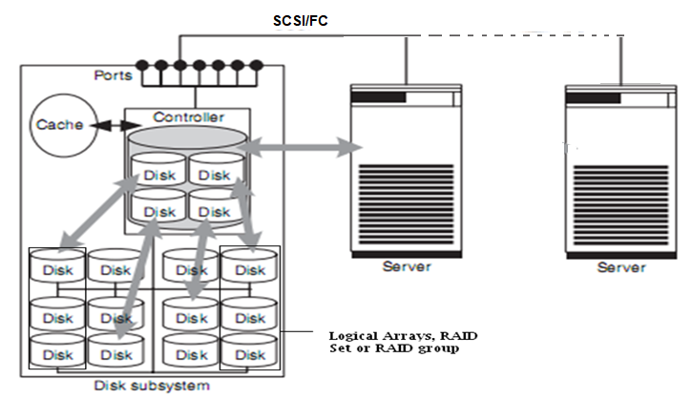
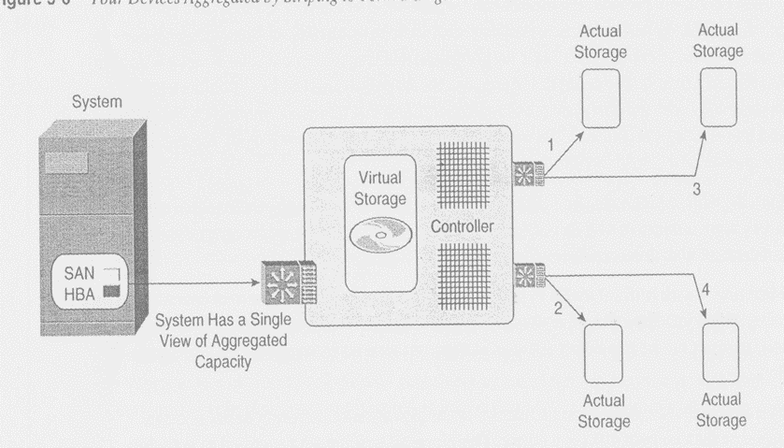
CLOUD COMPUTING
Typical Architecture of a Storage Device/Subsystem
Figure shows a controller between the disks and the ports
External Ports are extended to disks through Internal IO Channels.
Controller functions help with
Increasing data availability and data access performance through RAID
Uses caches to speedup read and write access to the server
Most reasonable disk subsystem would contain
Redundant controllers
Significant Cache
Storage Disks which can support petabytes of disks
Could weigh over a ton with the size of a large wardrobe
Consolidated disks which provide better utilization of disks

Slide 10
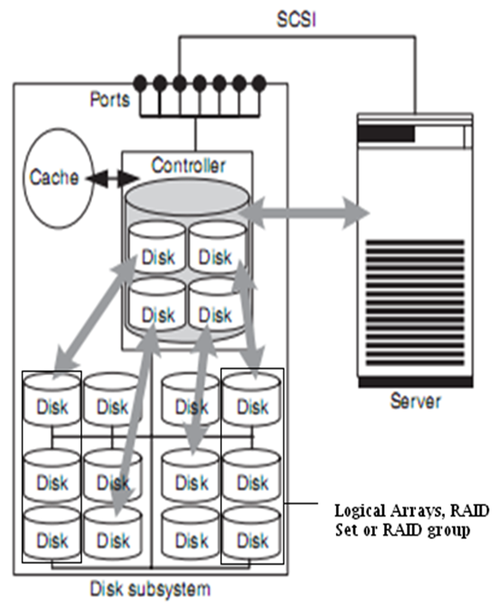
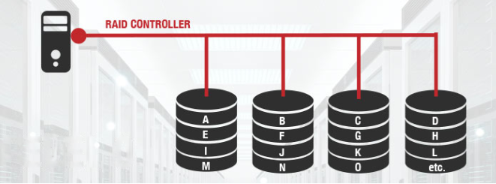
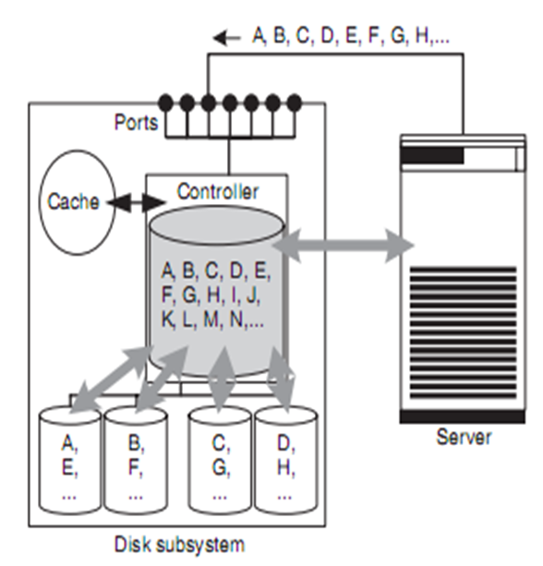
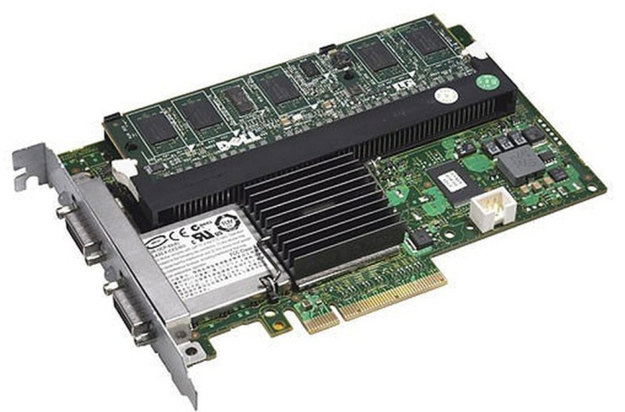
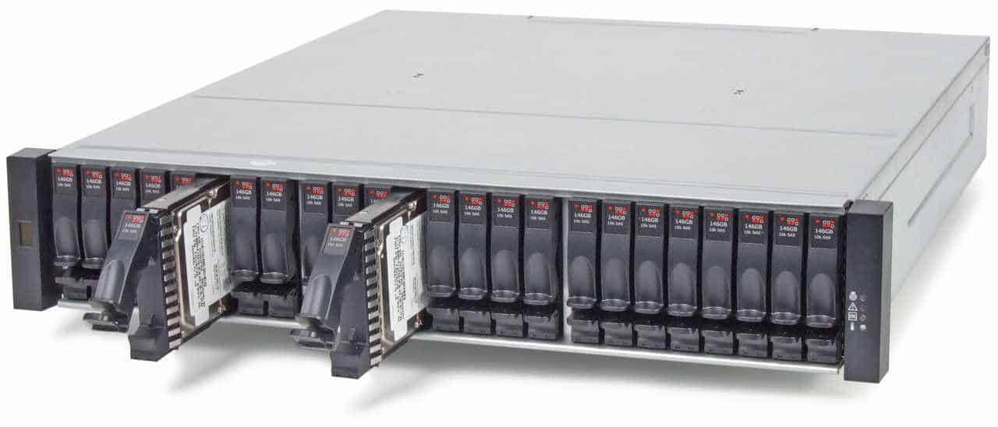
CLOUD COMPUTING
RAID – Redundant Array of Independent Disks
SCSI/FC
RAID is a data storage virtualization technology that combines multiple physical disk drive components into one or more logical units for the purposes of data redundancy and performance improvement.
Data is distributed across the drives in one of several ways, referred to as RAID levels, depending on the required level of redundancy and performance
Eg. RAID 0, RAID 1, RAID 4, ….
RAID 0

Slide 11
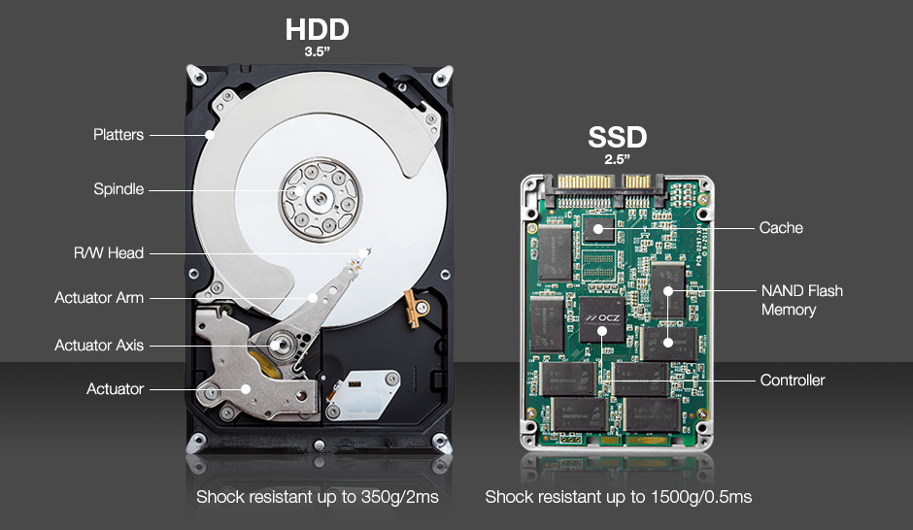
CLOUD COMPUTING
Typical Storage devices within this disk subsystems :

Slide 12
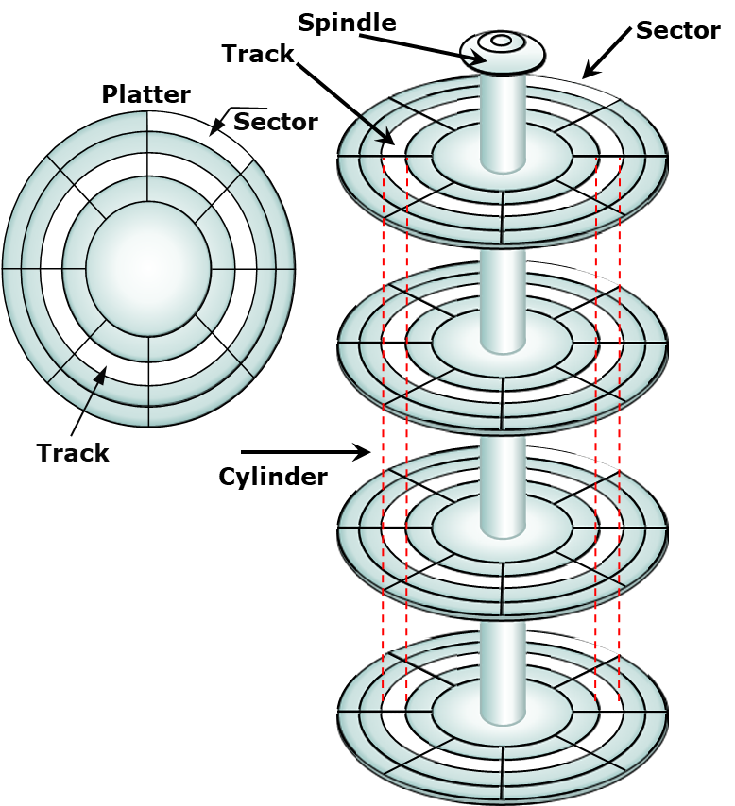
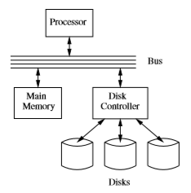
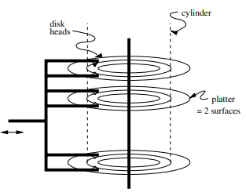
CLOUD COMPUTING
Magnetic Disk Structure and Disk Latency
Reading or writing a block involves three steps
The disk controller positions the head assembly at the cylinder containing the track on which the block is located. The time to do so is the seek time
The disk controller waits while the first sector of the block moves under the head. This time is called the rotational latency.
All the sectors and the gaps between them pass under the head, while the disk controller reads or writes data in these sectors. This delay is called the transfer time
Disk Latency = Seek time + Rotational latency + Transfer time

Slide 13
THANK YOU
Prafullata Kiran Auradkar
Department of Computer Science and Engineering
prafullatak@pes.edu

